Slide 1
Combinational Circuits
Output is function of input only
i.e. no feedback
When input changes, output may change (after a delay)
Combinational
Circuits
n inputs
m outputs
•
•
•
•
•
•
✗

Slide 2
Combinational Circuits
Analysis
Given a circuit, find out its function
Function may be expressed as:
Boolean function
Truth table
Design
Given a desired function, determine its circuit
Function may be expressed as:
Boolean function
Truth table
?
?
?

Slide 3
C A N O N I C A L FORM
Minterms (standard product)
A Boolean function can be expressed algebraically from a given truth table by forming a minterm(ANDed literals) for each combination of the variables that produces a 1 in the function and then taking the OR of all those terms
Maxterms (standard Sum)
It is important to note that
each maxterm is obtained from an OR term of n variables, with each variable being unprimed if the corresponding bit is a 0 and primed if a 1, and
each maxterm is the complement of its corresponding minterm and vice versa

Slide 4
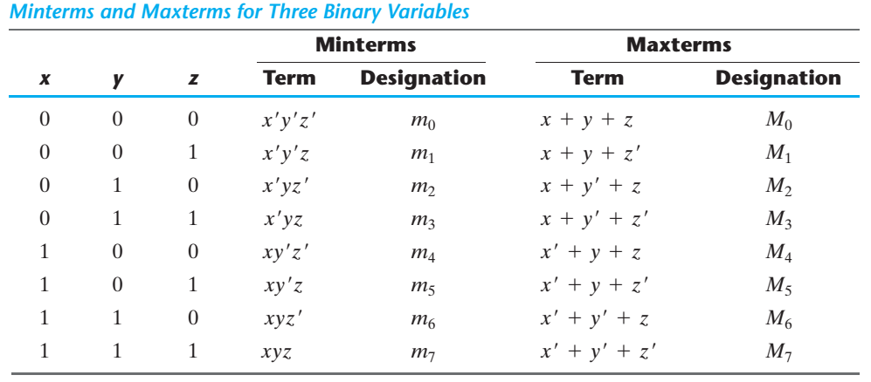

Slide 5
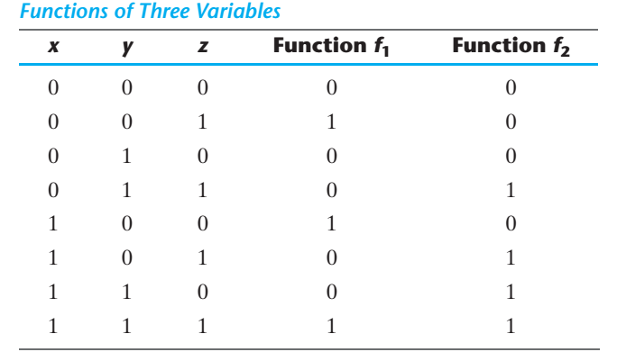
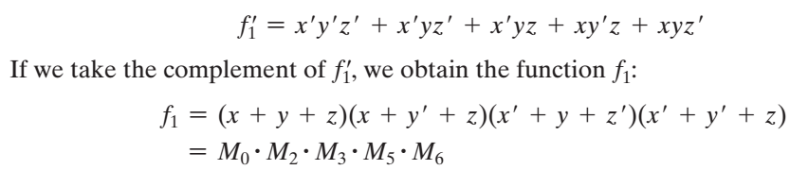

Slide 6
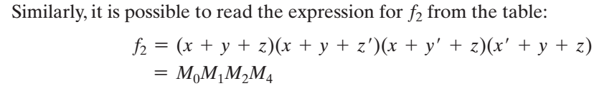
These examples demonstrate a second property of Boolean algebra: Any Boolean function can be expressed as a product of maxterms (with “product” meaning the ANDing of terms).

Slide 7
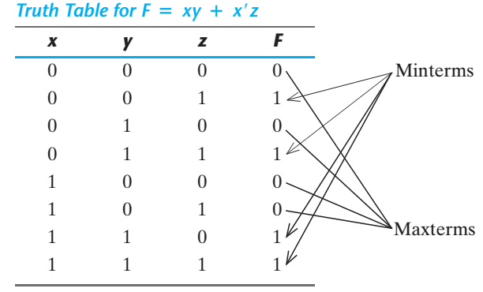



Canonical form
Boolean functions expressed as a sum of minterms or product of maxterms are said to be in canonical form .
When a Boolean function is in its sum‐of‐minterms form, it is sometimes convenient to express the function in the following brief notation:

Slide 8
Analysis Procedure
Truth Table Approach
A B C | F₁ | F₂
0 0 0 | 0 | 0
0 0 1 | 1 | 0
0 1 0 | 1 | 0
0 1 1 | 0 | 1
1 0 0 | 1 | 0
1 0 1 | 0 | 1
1 1 0 | 0 | 1
1 1 1
= 1
= 1
= 1
= 1
= 1
= 1
= 1
= 1
= 1
= 1
= 1
= 1
1
1
1
1
1
1
0
0
1
1 1
 |  |  |  | B
 |  | 0 | 1 | 0 | 1
A |  | 1 | 0 | 1 | 0
 |  |  | C
 |  |  |  | B
 |  | 0 | 0 | 1 | 0
A |  | 0 | 1 | 1 | 1
 |  |  | C
F₁=AB'C'+A'BC'+A'B'C+ABC
F₂=AB+AC+BC

Slide 9
NAND Logic
Example
Convert the circuit in the previous example to one that uses only NAND gates.
Solution
Recall from Boolean algebra that double inversion cancels. By adding inverting bubbles to above circuit, it is easily converted to NAND gates:
A
C
X =
A
C
+
A
B
A
B

Slide 10
Universal Gates
NAND gates are sometimes called universal gates because they can be used to produce the other basic Boolean functions.
A
A
A
AB
B
Inverter
AND gate
A
A
A + B
A + B
B
B
OR gate
NOR gate

Slide 11
Universal Gates
NOR gates are also universal gates and can form all of the basic gates.
A
A
A
A + B
B
Inverter
OR gate
A
A
AB
AB
B
B
AND gate
NAND gate

Slide 12
NAND Logic
Recall from DeMorgan’s theorem that AB = A + B. By using equivalent symbols, it is simpler to read the logic of SOP forms. The earlier example shows the idea:
A
C
X =
A
C
+
A
B
A
B
The logic is easy to read if you (mentally) cancel the two connected bubbles on a line.

Slide 13
NOR Logic
Alternatively, DeMorgan’s theorem can be written as A + B = A B. By using equivalent symbols, it is simpler to read the logic of POS forms. For example,
A
B
X =
(A + B)(A + C)
A
C
Again, the logic is easy to read if you cancel the two connected bubbles on a line.

Slide 14
Design Procedure
Given a problem statement:
Determine the number of inputs and outputs
Derive the truth table
Simplify the Boolean expression for each output
Produce the required circuit
Example:
Design a circuit to convert a “BCD” code to “Excess 3” code
4-bits
0-9 values
?
4-bits
Value+3

Slide 15
Design Procedure
BCD-to-Excess 3 Converter
 |  |  |  | C
 |  |  | 1 | 1 | 1 | B
A |  | x | x | x | x
 |  | 1 | 1 | x | x
 |  |  | D
 |  |  |  | C
 |  |  | 1 | 1 | 1
 |  | 1 |  |  |  | B
A |  | x | x | x | x
 |  |  | 1 | x | x
 |  |  | D
A B C D | w x y z
0 0 0 0 | 0 0 1 1
0 0 0 1 | 0 1 0 0
0 0 1 0 | 0 1 0 1
0 0 1 1 | 0 1 1 0
0 1 0 0 | 0 1 1 1
0 1 0 1 | 1 0 0 0
0 1 1 0 | 1 0 0 1
0 1 1 1 | 1 0 1 0
1 0 0 0 | 1 0 1 1
1 0 0 1 | 1 1 0 0
1 0 1 0 | x x x x
1 0 1 1 | x x x x
1 1 0 0 | x x x x
1 1 0 1 | x x x x
1 1 1 0 | x x x x
1 1 1 1 | x x x x
w = A+BC+BD
x = B’C+B’D+BC’D’
 |  |  |  | C
 |  | 1 |  | 1
 |  | 1 |  | 1 |  | B
A |  | x | x | x | x
 |  | 1 |  | x | x
 |  |  | D
 |  |  |  | C
 |  | 1 |  |  | 1
 |  | 1 |  |  | 1 | B
A |  | x | x | x | x
 |  | 1 |  | x | x
 |  |  | D
y = C’D’+CD
z = D’

Slide 16
Design Procedure
BCD-to-Excess 3 Converter
A B C D | w x y z
0 0 0 0 | 0 0 1 1
0 0 0 1 | 0 1 0 0
0 0 1 0 | 0 1 0 1
0 0 1 1 | 0 1 1 0
0 1 0 0 | 0 1 1 1
0 1 0 1 | 1 0 0 0
0 1 1 0 | 1 0 0 1
0 1 1 1 | 1 0 1 0
1 0 0 0 | 1 0 1 1
1 0 0 1 | 1 1 0 0
1 0 1 0 | x x x x
1 0 1 1 | x x x x
1 1 0 0 | x x x x
1 1 0 1 | x x x x
1 1 1 0 | x x x x
1 1 1 1 | x x x x
w = A + B(C+D)
y = (C+D)’ + CD
x = B’(C+D) + B(C+D)’
z = D’

Slide 17
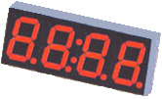
Seven-Segment Decoder
a
w x y z | a b c d e f g
0 0 0 0 | 1 1 1 1 1 1 0
0 0 0 1 | 0 1 1 0 0 0 0
0 0 1 0 | 1 1 0 1 1 0 1
0 0 1 1 | 1 1 1 1 0 0 1
0 1 0 0 | 0 1 1 0 0 1 1
0 1 0 1 | 1 0 1 1 0 1 1
0 1 1 0 | 1 0 1 1 1 1 1
0 1 1 1 | 1 1 1 0 0 0 0
1 0 0 0 | 1 1 1 1 1 1 1
1 0 0 1 | 1 1 1 1 0 1 1
1 0 1 0 | x x x x x x x
1 0 1 1 | x x x x x x x
1 1 0 0 | x x x x x x x
1 1 0 1 | x x x x x x x
1 1 1 0 | x x x x x x x
1 1 1 1 | x x x x x x x
w
x
y
z
a
b
c
d
e
f
g
f
b
?
g
e
c
BCD code
d
 |  |  |  | y
 |  | 1 |  | 1 | 1
 |  |  | 1 | 1 | 1 | x
w |  | x | x | x | x
 |  | 1 | 1 | x | x
 |  |  | z
a = w + y + xz + x’z’
b = . . .
c = . . .
d = . . .

Slide 18
Binary Adder
Half Adder
Adds 1-bit plus 1-bit
Produces Sum and Carry
x
y
S
C
HA
x
+ y
───
C S
x y | C S
0 0 | 0 0
0 1 | 0 1
1 0 | 0 1
1 1 | 1 0
x
y
S
C

Slide 19
Binary Adder
Full Adder
Adds 1-bit plus 1-bit plus 1-bit
Produces Sum and Carry
x
y
z
S
C
FA
x
+ y
+ z
───
C S
x y z | C S
0 0 0 | 0 0
0 0 1 | 0 1
0 1 0 | 0 1
0 1 1 | 1 0
1 0 0 | 0 1
1 0 1 | 1 0
1 1 0 | 1 0
1 1 1 | 1 1
 |  |  |  | y
 |  | 0 | 1 | 0 | 1
x |  | 1 | 0 | 1 | 0
 |  |  | z
S = xy'z'+x'yz'+x'y'z+xyz = x ⊕ y ⊕ z
 |  |  |  | y
 |  | 0 | 0 | 1 | 0
x |  | 0 | 1 | 1 | 1
 |  |  | z
C = xy + xz + yz

Slide 20
Binary Adder
Full Adder
S = xy'z'+x'yz'+x'y'z+xyz = x ⊕ y ⊕ z
C = xy + xz + yz
x
y
z
S
C
S
C
x
y
z

Slide 21



Binary Adder
Full Adder
HA
HA
x
y
z
S
C
x
y
z
S
C

Slide 22
Binary Adder
x₃x₂x₁x₀ y₃y₂y₁y₀
c₃ c₂ c₁ .
+ x₃ x₂ x₁ x₀
+ y₃ y₂ y₁ y₀
────────
Cy S₃ S₂ S₁ S₀
Binary Adder
Carry Propagate Addition
C_{y}
C₀
S₃S₂S₁S₀
x₃ x₂ x₁ x₀
y₃ y₂ y₁ y₀
0
FA
FA
FA
FA
C₄ C₃ C₂ C₁
S₃ S₂ S₁ S₀

Slide 23
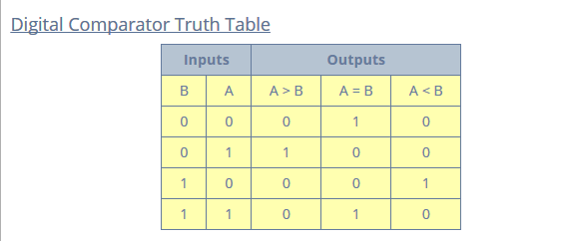
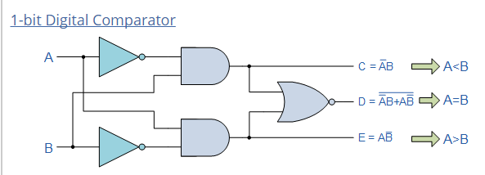
1 bit comparator

Slide 24
Decoders
Extract “Information” from the code
Binary Decoder
Example: 2-bit Binary Number
Only one lamp will turn on
0
1
2
3
Binary Decoder
1
0
0
0
x₁
x₀
0
0

Slide 25
Decoders
2-to-4 Line Decoder
Binary Decoder
y₃
y₂
y₁
y₀
I₁
I₀
I₁ I₀ | Y₃ Y₂ Y₁ Y₀
0 0 | 0 0 0 1
0 1 | 0 0 1 0
1 0 | 0 1 0 0
1 1 | 1 0 0 0

Slide 26
Decoders
3-to-8 Line Decoder
Binary Decoder
Y₇
Y₆
Y₅
Y₄ Y₃
Y₂
Y₁
Y₀
I₂
I₁
I₀

Slide 27
Decoders
“Enable” Control
Binary Decoder
Y₃
Y₂
Y₁
Y₀
I₁
I₀
E
E | I₁ I₀ | Y₃ Y₂ Y₁ Y₀
0 | x x | 0 0 0 0
1 | 0 0 | 0 0 0 1
1 | 0 1 | 0 0 1 0
1 | 1 0 | 0 1 0 0
1 | 1 1 | 1 0 0 0

Slide 28
Decoders
Expansion
I₂ I₁ I₀
I₂ I₁ I₀ | Y₇ Y₆ Y₅ Y₄ Y₃ Y₂ Y₁ Y₀
0 0 0 | 0 0 0 0 0 0 0 1
0 0 1 | 0 0 0 0 0 0 1 0
0 1 0 | 0 0 0 0 0 1 0 0
0 1 1 | 0 0 0 0 1 0 0 0
1 0 0 | 0 0 0 1 0 0 0 0
1 0 1 | 0 0 1 0 0 0 0 0
1 1 0 | 0 1 0 0 0 0 0 0
1 1 1 | 1 0 0 0 0 0 0 0
Binary Decoder
Y₇
Y₆
Y₅
Y₄
Y₃
Y₂
Y₁
Y₀
Y₃
Y₂
Y₁
Y₀
I₀
I₁
E
Binary Decoder
Y₃
Y₂
Y₁
Y₀
I₀
I₁
E

Slide 29
Implementation Using Decoders
Each output is a minterm
All minterms are produced
Sum the required minterms
Example: Full Adder
S(x, y, z) = ∑(1, 2, 4, 7)
C(x, y, z) = ∑(3, 5, 6, 7)
Binary Decoder
Y₇
Y₆
Y₅
Y₄ Y₃
Y₂
Y₁
Y₀
x
y
z
I₂
I₁
I₀
S C

Slide 30
Implementation Using Decoders
Binary Decoder
Binary Decoder
Y₇
Y₆
Y₅
Y₄ Y₃
Y₂
Y₁
Y₀
Y₇
Y₆
Y₅
Y₄
Y₃
Y₂
Y₁
Y₀
x
y
z
I₂
I₁
I₀
x
y
z
I₂
I₁
I₀
S C
S C

Slide 31
Encoders
Put “Information” into code
Binary Encoder
Example: 4-to-2 Binary Encoder
Only one switch should be activated at a time
1
x₁
x₂
x₃
Binary Encoder
x₃ x₂ x₁ | y₁ y₀
0 0 0 | 0 0
0 0 1 | 0 1
0 1 0 | 1 0
1 0 0 | 1 1
y₁
y₀
2
3

Slide 32
Encoders
Octal-to-Binary Encoder (8-to-3)
Binary Encoder
I₇
I₆
I₅
I₄ I₃
I₂
I₁
I₀
I₇ I₆ I₅ I₄ I₃ I₂ I₁ I₀ | Y₂ Y₁ Y₀
0 0 0 0 0 0 0 1 | 0 0 0
0 0 0 0 0 0 1 0 | 0 0 1
0 0 0 0 0 1 0 0 | 0 1 0
0 0 0 0 1 0 0 0 | 0 1 1
0 0 0 1 0 0 0 0 | 1 0 0
0 0 1 0 0 0 0 0 | 1 0 1
0 1 0 0 0 0 0 0 | 1 1 0
1 0 0 0 0 0 0 0 | 1 1 1
Y₂
Y₁
Y₀

Slide 33
Encoder / Decoder Pairs
Binary Encoder
Binary Decoder
Y₇
Y₆
Y₅
Y₄ Y₃
Y₂
Y₁
Y₀
7
7
I₇
I₆
I₅
I₄ I₃
I₂
I₁
I₀
6
6
5
5
Y₂
Y₁
Y₀
I₂
I₁
I₀
4
4
3
3
2
2
1
1
0
0

Slide 34
Multiplexers
S₁ S₀ | Y
0 0 | I₀
0 1 | I₁
1 0 | I₂
1 1 | I₃
MUX
I₀
I₁
I₂
I₃
Y
S₁ S₀

Slide 35
Multiplexers
2-to-1 MUX
4-to-1 MUX
MUX
I₀
I₁
Y
S
MUX
I₀
I₁
I₂
I₃
Y
S₁ S₀

Slide 36
Multiplexers
Quad 2-to-1 MUX
x₃
x₂
x₁
x₀
MUX
I₀
I₁
y₃
y₂
y₁
y₀
Y
S
MUX
I₀
I₁
Y
S
MUX
A₃
A₂
A₁
A₀
MUX
I₀
I₁
Y₃
Y₂
Y₁
Y₀
Y
S
B₃
B₂
B₁
B₀
MUX
I₀
I₁
Y
S
S E
S

Slide 37
Implementation Using Multiplexers
Example F(x, y) = ∑(0, 1, 3)
x y | F
0 0 | 1
0 1 | 1
1 0 | 0
1 1 | 1
MUX
1
1
0
1
I₀
I₁
I₂
I₃
Y
F
S₁ S₀
x y

Slide 38
Implementation Using Multiplexers
Example F(x, y, z) = ∑(1, 2, 6, 7)
MUX
0
1
1
0
0
0
1
1
I₀
I₁
I₂
I₃ I₄
I₅
I₆
I₇
x y z | F
0 0 0 | 0
0 0 1 | 1
0 1 0 | 1
0 1 1 | 0
1 0 0 | 0
1 0 1 | 0
1 1 0 | 1
1 1 1 | 1
Y
F
S₂ S₁ S₀
x y z

Slide 39
Implementation Using Multiplexers
Example F(x, y, z) = ∑(1, 2, 6, 7)
x y z | F
0 0 0 | 0
0 0 1 | 1
0 1 0 | 1
0 1 1 | 0
1 0 0 | 0
1 0 1 | 0
1 1 0 | 1
1 1 1 | 1
z
MUX
I₀
I₁
I₂
I₃
F = z
F
z
0
Y
F = z
1
S₁ S₀
F = 0
x y
F = 1

Slide 40
Implementation Using Multiplexers
Example F(A, B, C, D) = ∑(1, 3, 4, 11, 12, 13, 14, 15)
A B C D | F
0 0 0 0 | 0
0 0 0 1 | 1
0 0 1 0 | 0
0 0 1 1 | 1
0 1 0 0 | 1
0 1 0 1 | 0
0 1 1 0 | 0
0 1 1 1 | 0
1 0 0 0 | 0
1 0 0 1 | 0
1 0 1 0 | 0
1 0 1 1 | 1
1 1 0 0 | 1
1 1 0 1 | 1
1 1 1 0 | 1
1 1 1 1 | 1
MUX
D
I₀
I₁
I₂
I₃ I₄
I₅
I₆
I₇
F = D
D
F = D
D
F = D
0
Y
F
0
F = 0
D
F = 0
1
F = D
1
S₂ S₁ S₀
F = 1
F = 1
A B C

Slide 41
Multiplexer Expansion
8-to-1 MUX using Dual 4-to-1 MUX
MUX
I₀
I₁
I₂
I₃
I₄
I₅
I₆
I₇
I₀
I₁
I₂
I₃
Y
S₁ S₀
MUX
I₀
I₁
Y
Y
MUX
S
I₀
I₁
I₂
I₃
Y
S₁ S₀
1
0 0
S₂ S₁ S₀

Slide 42
DeMultiplexers
DeMUX
Y₃
Y₂
Y₁
Y₀
I
S₁ S₀
S₁ S₀ | Y₃ | Y₂ | Y₁ | Y₀
0 0 | 0 | 0 | 0 | I
0 1 | 0 | 0 | I | 0
1 0 | 0 | I | 0 | 0
1 1 | I | 0 | 0 | 0

Slide 43
Multiplexer / DeMultiplexer Pairs
MUX
DeMUX
Y₇
Y₆
Y₅
Y₄ Y₃
Y₂
Y₁
Y₀
7
7
I₇
I₆
I₅
I₄ I₃
I₂
I₁
I₀
6
6
5
5
4
4
Y
I
3
3
2
2
1
1
0
0
S₂ S₁ S₀
S₂ S₁ S₀
Synchronize
x₂ x₁ x₀
y₂ y₁ y₀

Slide 44
DeMultiplexers / Decoders
DeMUX
Binary Decoder
Y₃
Y₂
Y₁
Y₀
Y₃
Y₂
Y₁
Y₀
I₁
I₀
E
I
S₁ S₀
E | I₁ I₀ | Y₃ Y₂ Y₁ Y₀
0 | x x | 0 0 0 0
1 | 0 0 | 0 0 0 1
1 | 0 1 | 0 0 1 0
1 | 1 0 | 0 1 0 0
1 | 1 1 | 1 0 0 0
S₁ S₀ | Y₃ | Y₂ | Y₁ | Y₀
0 0 | 0 | 0 | 0 | I
0 1 | 0 | 0 | I | 0
1 0 | 0 | I | 0 | 0
1 1 | I | 0 | 0 | 0

